Slide 1
DATA SCIENCE PROJECT ON FINDING RESTAURANTS IN LOS ANGELES

Slide 2
Introduction:
Business Problem
With an estimated population of nearly four million people, Los Angeles is the second-most populous city in the United States. It has a diverse economy and hosts businesses in a broad range of professional and cultural fields. It is also arguably the most amazing place to eat in America, owing to an incredible variety of international cuisines and some of the most talented chefs in the world. LA’s great seasonal produce and access to ingredients makes it an ideal place for restaurants to thrive — but how do you know which ones to go to? How do you know where to set up your restaurant? As daunting this may sound, it is possible to know what the best places to get something to eat are with Foursquare.

Slide 3
Target Audience
Entrepreneurs seeking to open a restaurant in Los Angeles and would like to map the competition in order to choose the best location.
People seeking to find the best restaurant to go to based on Foursquare likes, restaurant category and geographic location data for restaurants in Los Angeles.

Slide 4
Data Description
I will be use the Foursquare API to pull the following location data on restaurants in Los Angeles, California:
Venue Name
Venue ID
Venue Location
Venue Category
Count of Likes
To acquire the aforementioned data, I will need to do the following:
Get the latitude and longitude coordinates for Los Angeles from the Geocoder library
Use Foursquare API to get a list of all venues in Los Angeles
I will then take the gathered data and create a k-means clustering algorithm that groups restaurants into 4-5 clusters so that people looking to start a restaurant or eat in Los Angeles can easily see which restaurants are the best to eat at and what cuisine is available.

Slide 5
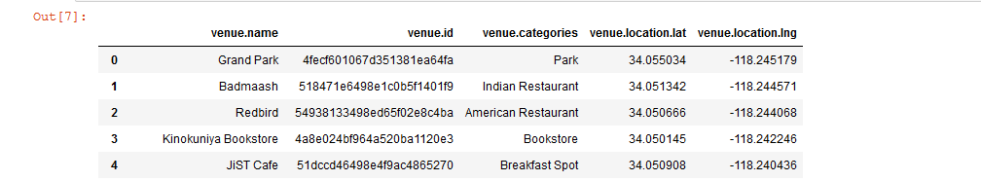
Methodology
I utilized the Foursquare API to explore the venues. I designed the limit as 100 venue and the radius 500 meter from 34.0536909N, 118.2427666W (Los Angeles). Here is a head of the list Venues name, category, latitude and longitude informations from Forsquare API:

Slide 6
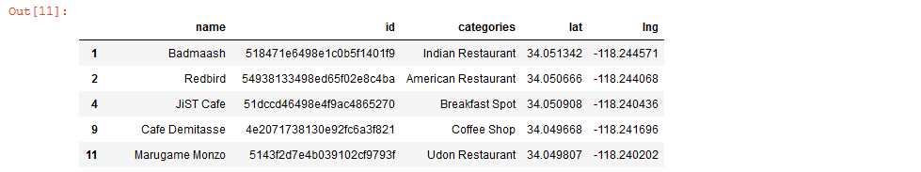
I used the unique () function to get a list of unique categories from the API in order to see what may or may not fit for restaurants. I removed the venues that are not restaurants and obtained the dataframe of restaurants only. Here is a head of the list Venues name, category, latitude and longitude informations from Forsquare API:

Slide 7
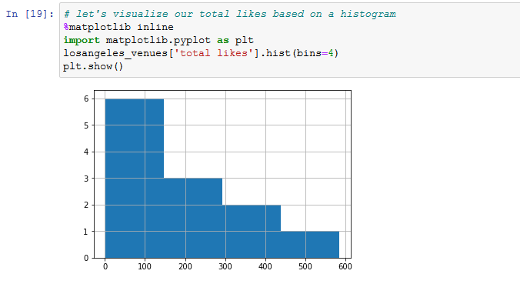
From the list of venue ids, I pulled the likes and added them to the dataframe. I bin the total likes and visualize the data with a histogram as shown below:

Slide 8
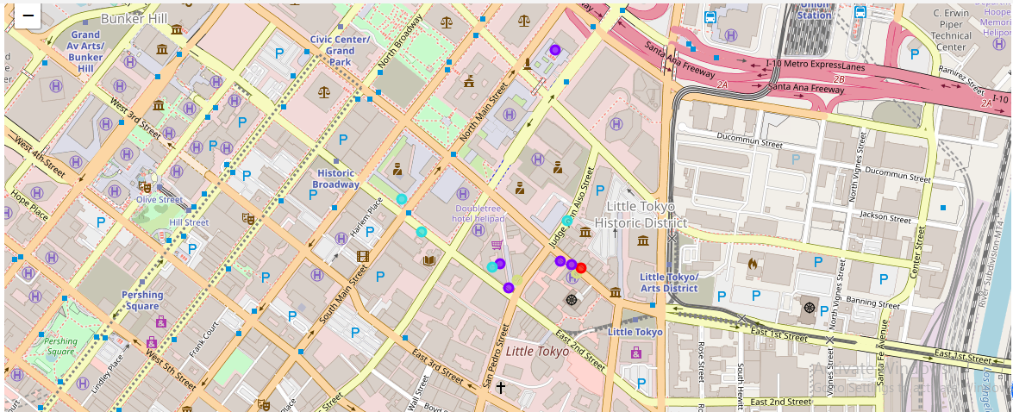
I categorized the data based on likes and used one hot encoding to represent the categorical data more expressively. I used unsupervised learning K-means algorithm to cluster the restaurants. I used python folium library to visualize the clusters as shown below:

Slide 9
Results
I represented the observations in 4 clusters.

Slide 10
Discussion
The thought process behind this is that likes are a proxy for quality. The more likes there are, the better the restaurant is. This might be incorrect but API call issues (how many I can use for free) holds me back from getting price / rating data.
I ended the study by visualizing the data and clustering the information.
We have divided the restaurants in Los Angeles into the 4 Clusters below:
Cluster 1: Poor quality food
Cluster 2: Below average quality food
Cluster 3: High quality food
Cluster 4: Above average quality food

Slide 11
Conclusion
In conclusion, there are different types of restaurants in Los Angeles and data analysis can provide plenty of useful information to meet one’s needs.

